Slide 1
"Proactive Excellence: Empowering Success Through Initiative"
Rupa Karella

Slide 2

Introduction
Being proactive involves
Taking responsibility and initiative
Anticipation and prevention

Slide 3
The Role of Proactivity in Achieving Goals
Time Management: prioritize their tasks and manage their time efficiently which helps in avoiding procrastination.
Initiative: take the initiative to create opportunities
Problem Solving: Being proactive enables individuals to find innovative solutions to challenges

Slide 4
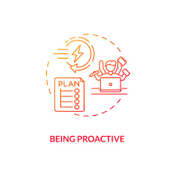
Adopting a Proactive Approach in Life
Prioritize tasks
Practice Continuous Learning
Take responsibility for your choices and learn from your experiences.
Adapt to the situation

Slide 5
Conclusion
In conclusion, embracing a proactive mindset is not just a choice; it's a powerful strategy for unlocking personal and professional success.

